Slide 1
Voice Controlled Smart Robot Car with MIT App

Slide 2
Contents
Overview
Objectives
Components Used
Software requirements
Implementation
Result and Output Images
Advantages
Conclusion

Slide 3
Overview
With the help of smart robot car sensor values are read from a particular sensor which are displayed in the MIT App.
Robot car is controlled with voice commands and MIT App interface.

Slide 4
Objectives
Smart Robot has to read the values of the DHT and Light sensors in the area of its movement.
Arduino is used to connect the sensors and send the values to the MIT App Inventor installed in the Android device.
When ever the sensors values are beyond the threshold limits, robot car alerts with the help of buzzer and LED.
The robot has to follow basic voice commands from user and act accordingly. Additionally robot car can be controlled with the buttons from MIT App Interface.

Slide 5
Components Used
Assembled Robot Car
Arduino UNO
Light Sensor
DHT Sensor
LED’s
Buzzer
Bluetooth Module
Bread Board
Connecting Wires

Slide 6
Software Requirements
MIT App Inventor
Arduino IDE

Slide 7
Implementation
First step is to assemble the Elegoo smart robot.
Connect the DHT, light sensors to the Arduino UNO of Elegoo Robot.
Code is written to display the sensor values in the Arduino serial monitor
We have created an app interface using MIT to control the robot and also to print the data from the sensors.
This data is coming dynamically from sensors and the app will display the same values that are coming from the sensors.
The next part is we are setting up MIT app interface which has got buttons to control the robot movement
We are also controlling the robot using voice commands.

Slide 8
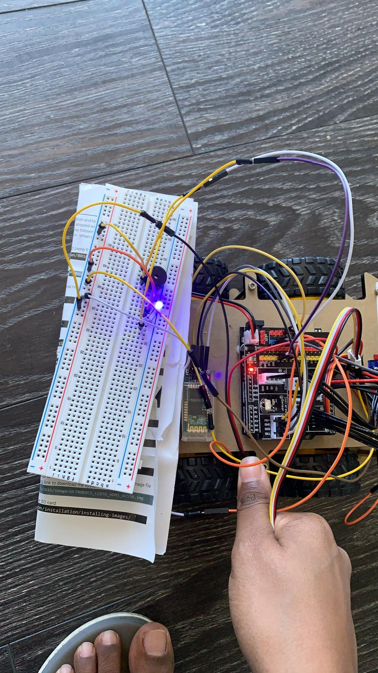
Result and Output Images
Sensor values are read by Elegoo smart robot which are displayed in app interface and alerts for the threshold values.

Slide 9
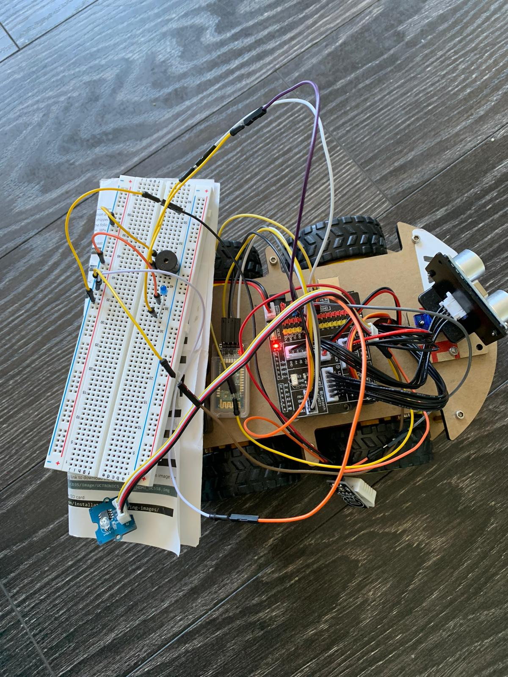

Slide 10
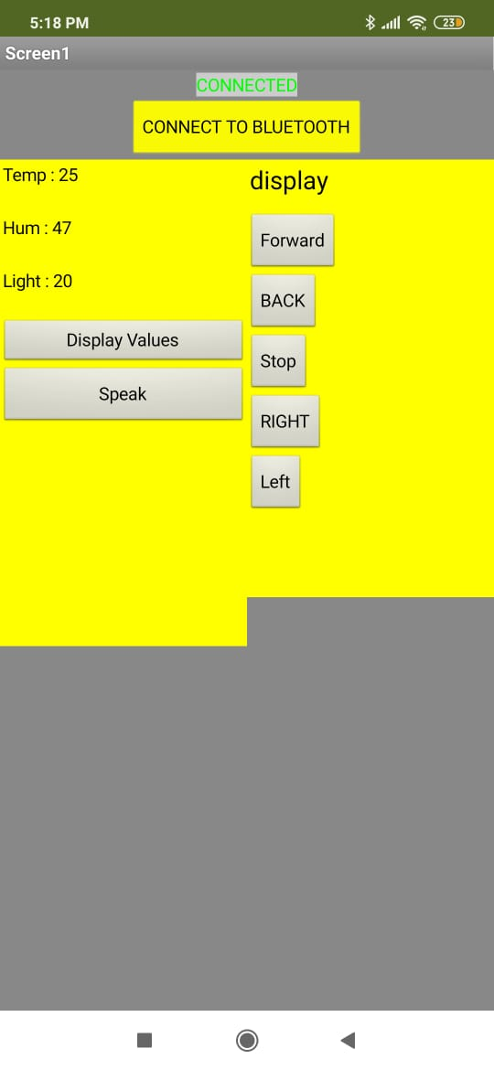

Slide 11
Advantages
This system can be used to monitor different conditions in home and also different places.
We can move robot around and the conditions at certain places can be recorded using different sensors attached to robot.
Robot can be controlled using voice and also a app, so there is no use for user to walk around to check its condition and also user can check the home conditions in his phone itself.

Slide 12
Conclusion
In this project we have learned how to assemble a Elegoo robot and how to work different sensors with Elegoo robot and taking that sensors value dynamically.
And we learned how to create a MIT app inventor to control all the sensor data and also how to control robot with MIT app.
We learned how to use speech recorder in MIT app to control robot with voice.

Slide 13
THANK YOU

